Slide 1

Marketing IT & Analytics Data Science Guild
— HR Analytics Project

Slide 2
Project Goals
Uncover factors that lead to employee attrition
Use different modeling techniques to create a prediction model to identify employee attrition

Slide 3

Data Profile
This dataset contains 1470 records and 35 columns.
' EmployeeNumber', 'Age', 'Attrition_Yes',
'BusinessTravel_Travel_Frequently', 'BusinessTravel_Travel_Rarely',
'Department_Research & Development', 'Department_Sales',
'DistanceFromHome', 'EducationField_Life Sciences',
'EducationField_Marketing', 'EducationField_Medical',
'EducationField_Other', 'EducationField_Technical Degree',
'PerformanceRating_4', 'EnvironmentSatisfaction', 'JobInvolvement',
'JobLevel', 'JobSatisfaction', 'JobRole_Healthcare Representative',
'JobRole_Human Resources', 'JobRole_Laboratory Technician',
'JobRole_Manager', 'JobRole_Manufacturing Director',
'JobRole_Research Director', 'JobRole_Research Scientist',
'JobRole_Sales Executive', 'JobRole_Sales Representative',
'Gender_Male', 'MaritalStatus_Divorced', 'MaritalStatus_Married',
'MaritalStatus_Single', 'MonthlyIncome', 'MonthlyRate',
'NumCompaniesWorked', 'PercentSalaryHike', 'RelationshipSatisfaction',
'StockOptionLevel', 'OverTime_Yes', 'NumCompaniesWorked_Ranges',
'PercentSalaryHike_Ranges', 'MonthlyIncome_Ranges', 'TotalWorkingYears',
'TrainingTimesLastYear', 'WorkLifeBalance', 'YearsAtCompany',
'YearsInCurrentRole', 'YearsSinceLastPromotion','YearsWithCurrManager'/
'Attrition'

Slide 4




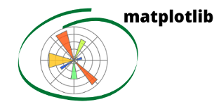
Data science toolkits in this project
Language:
Python
Data processing:
pandas
numpy
Plotting:
matplotlib
seaborn
ML:
Sklearn

Slide 5

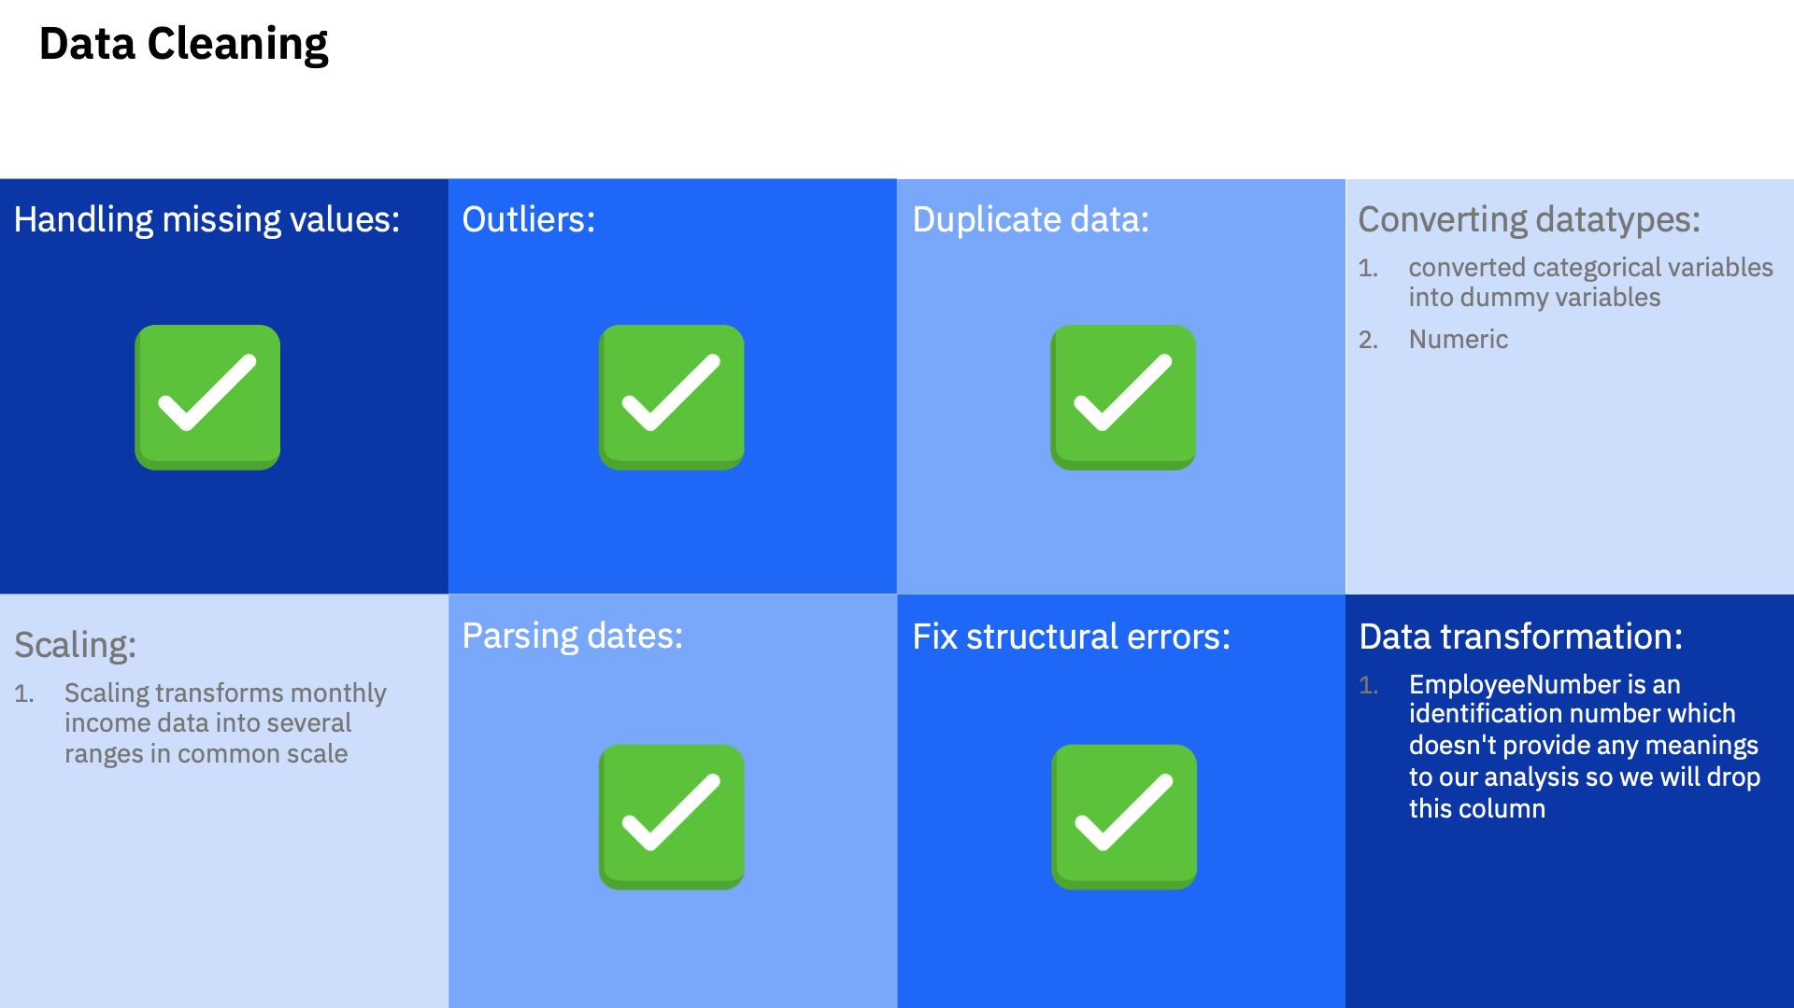
Data Wrangling

Slide 6
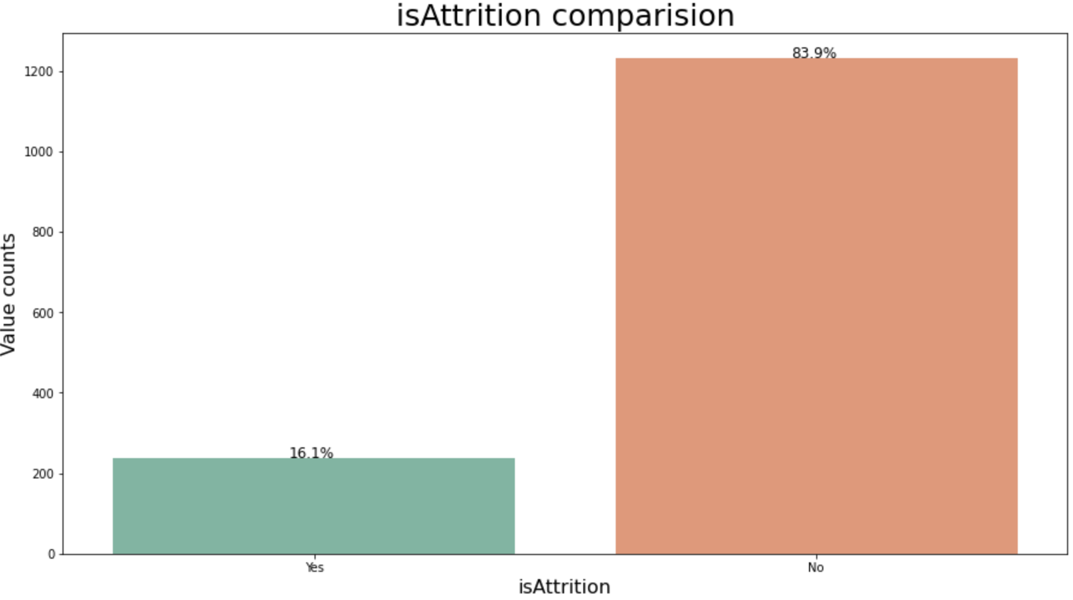
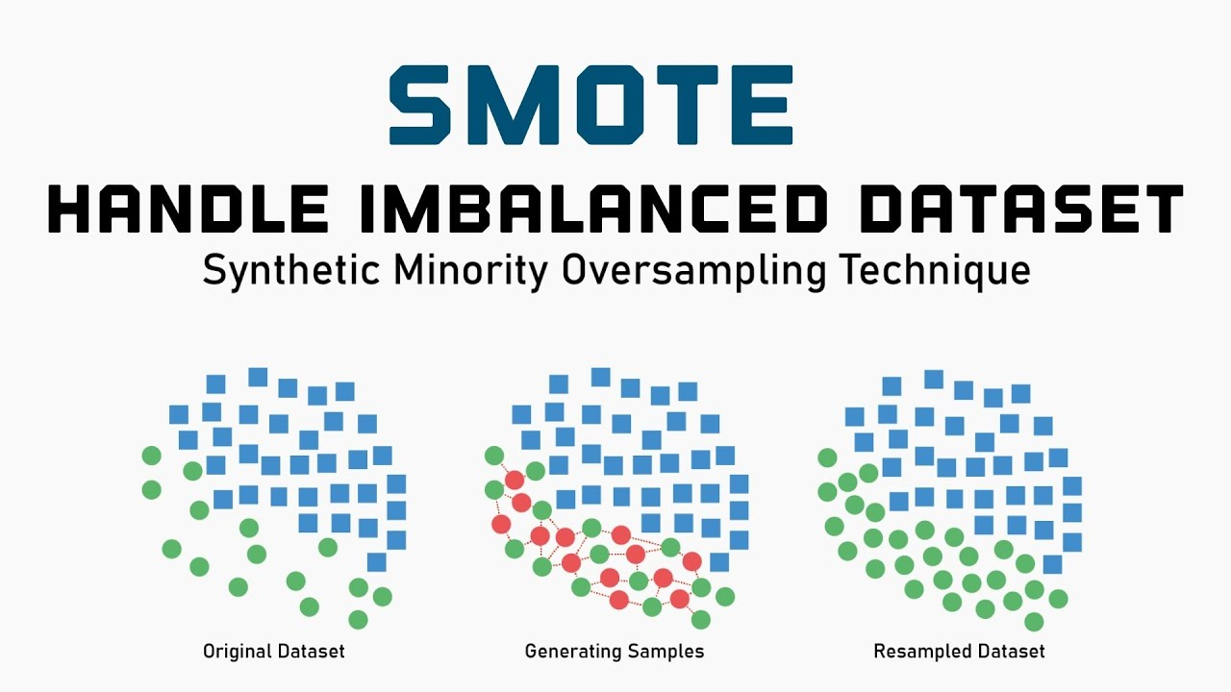
Data Wrangling
- Oversampling using SMOTE
* SMOTE (synthetic minority oversampling technique) is one of the most commonly used oversampling methods to solve the imbalance problem. It aims to balance class distribution by randomly increasing minority class examples by replicating them.

Slide 7
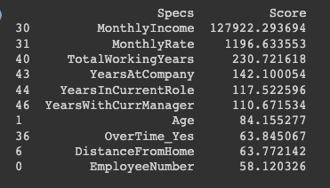
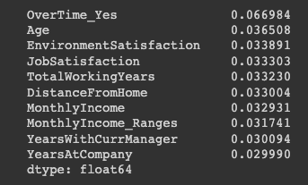
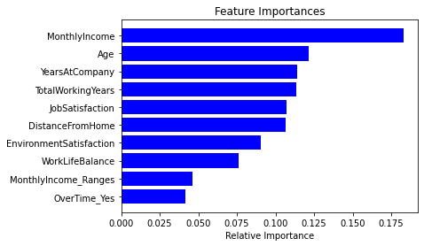
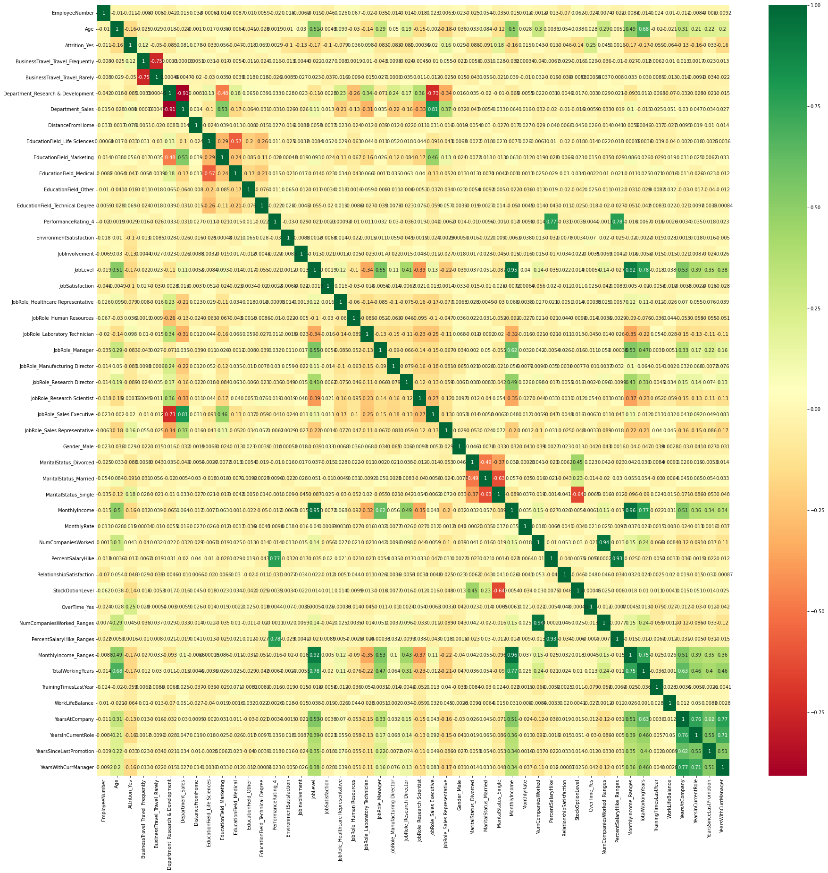
What features may contribute to Attrition?
Univariate Selection
inbuilt class feature_importances of tree based classifiers
Extra-trees classifier
Correlation Matrix with Heatmap

Slide 8
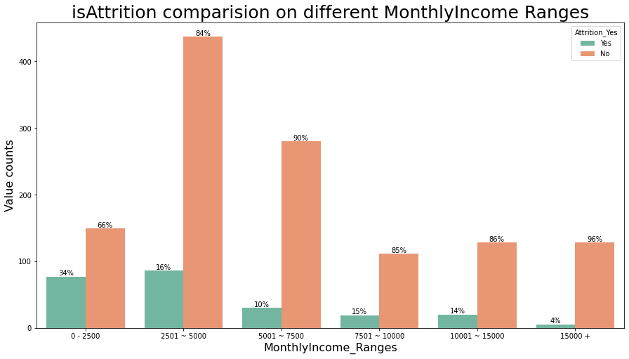
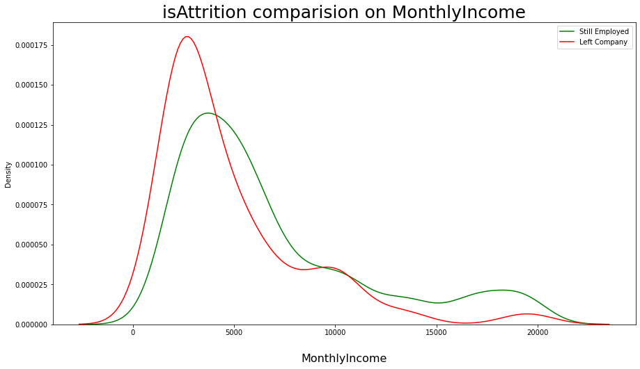
Exploratory Data Analysis - Monthly Income
KDE plot represents the probability distribution of the data values as the area under the plotted curve.
*Most employees have around $5000 monthly income and employees who earned around $2500 are more likely to leave the company

Slide 9
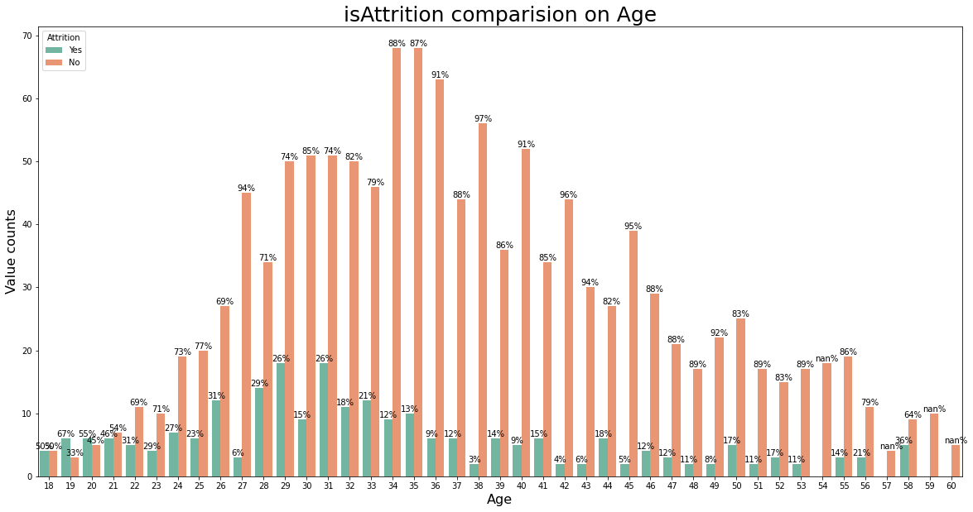
Exploratory Data Analysis - Age
employees who have 19 years old is the most attrition
A majority of people worked at IBM are between 26 and 45 years old
Seems as if the majority of employees who leave the company are less than 33 years old.

Slide 10
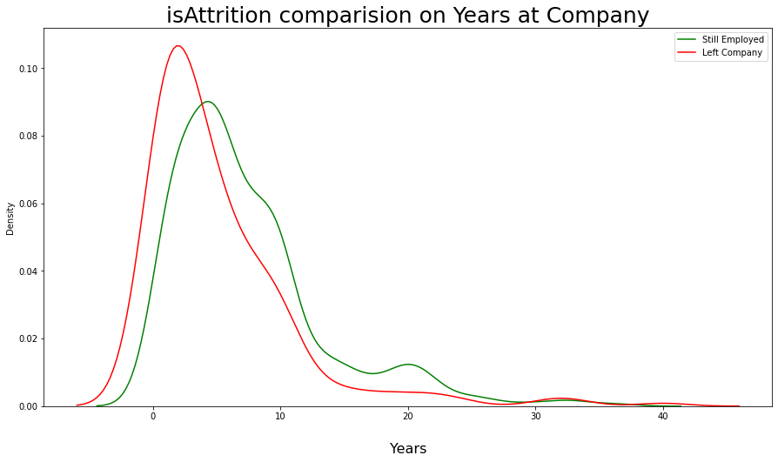

Exploratory Data Analysis - Years from kernel density estimate (KDE) plot
KDE plot represents the probability distribution of the data values as the area under the plotted curve.
*Employees who leave the company dont seem to spend a long time with the company.
Employees who leave the company usually don’t have a long total working years (less than 7 years) experience.

Slide 11
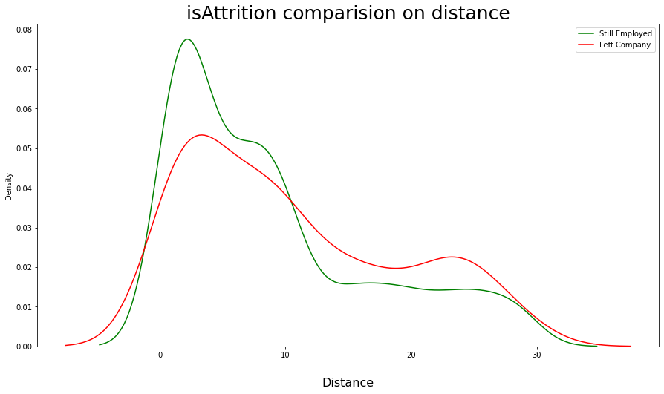
Exploratory Data Analysis - Distance from Home
*Employees who commute a longer distance (> 10 miles) contribute a lot to attrition.

Slide 12
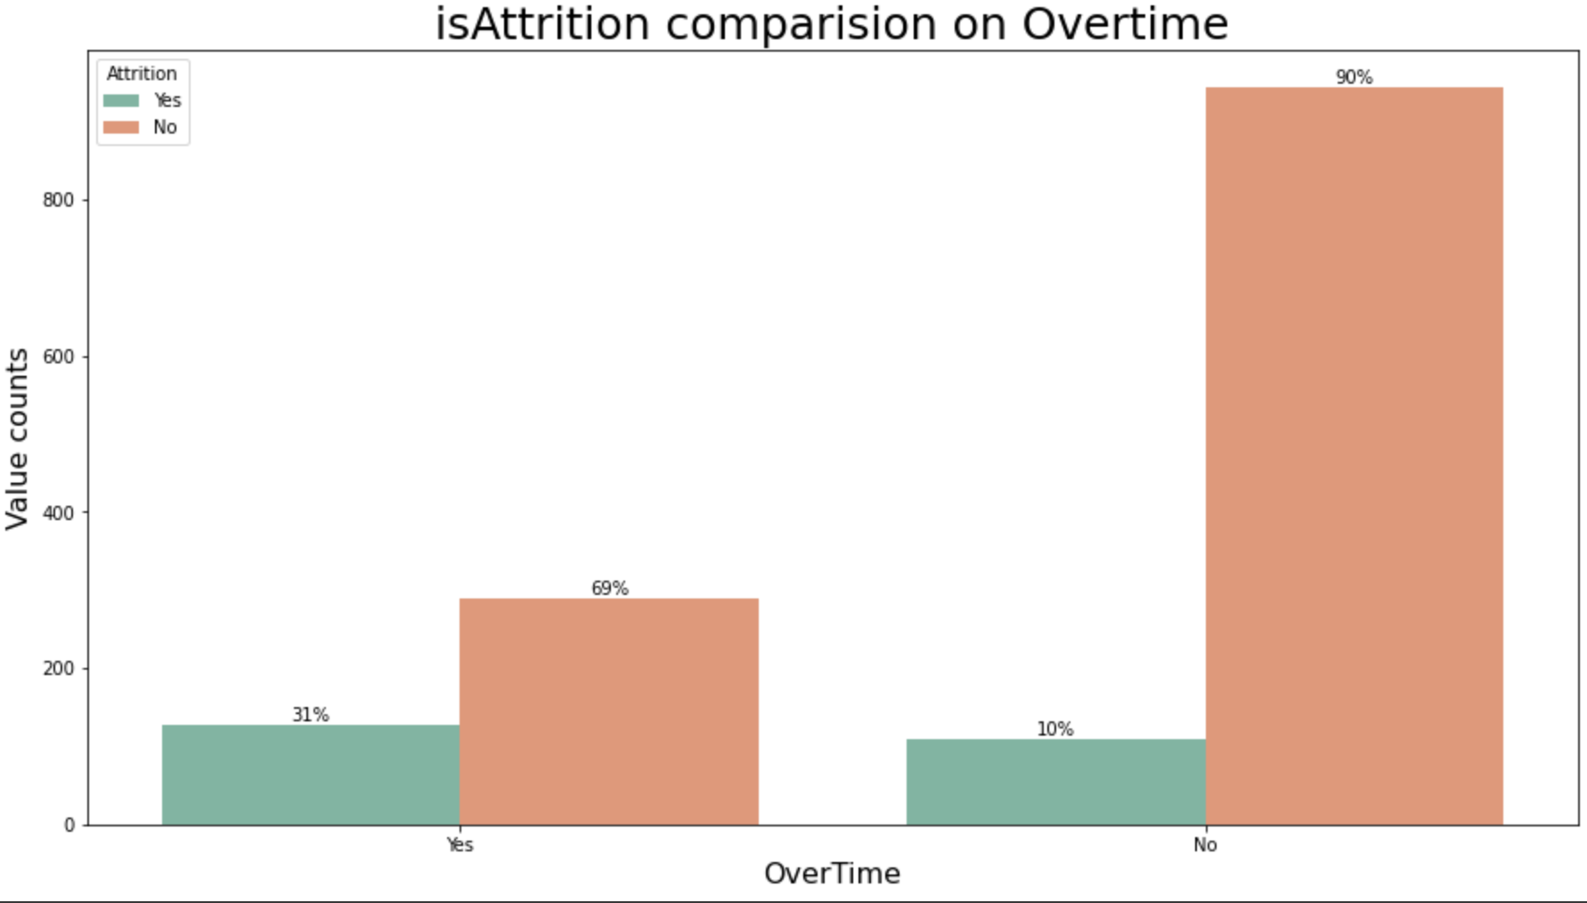
Exploratory Data Analysis - OverTime
*Employees who work overtime is more likely to leave the company

Slide 13
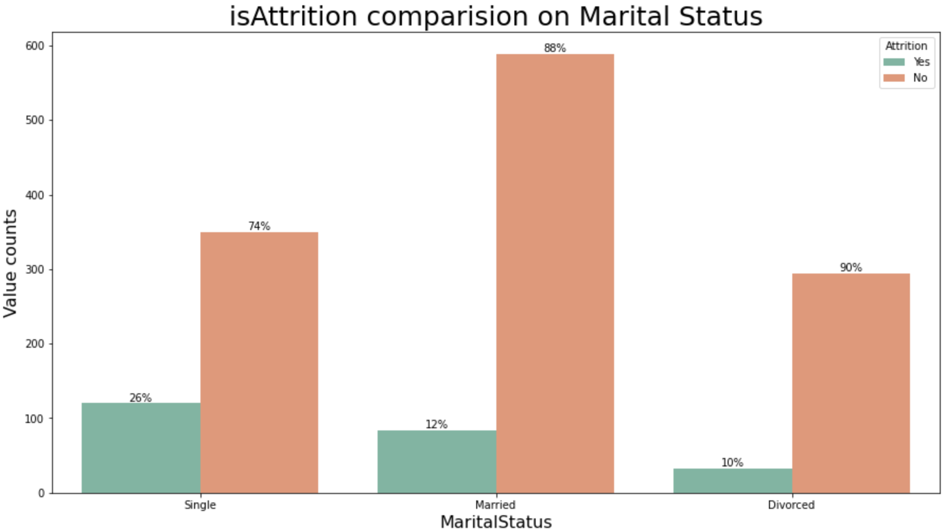
Exploratory Data Analysis -
Marital Status
*Single person has the highest attrition rate.

Slide 14
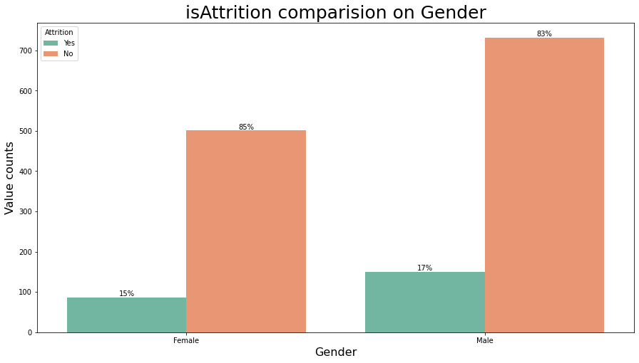
Exploratory Data Analysis -
Gender
*Attrition is relatively even between genders.

Slide 15
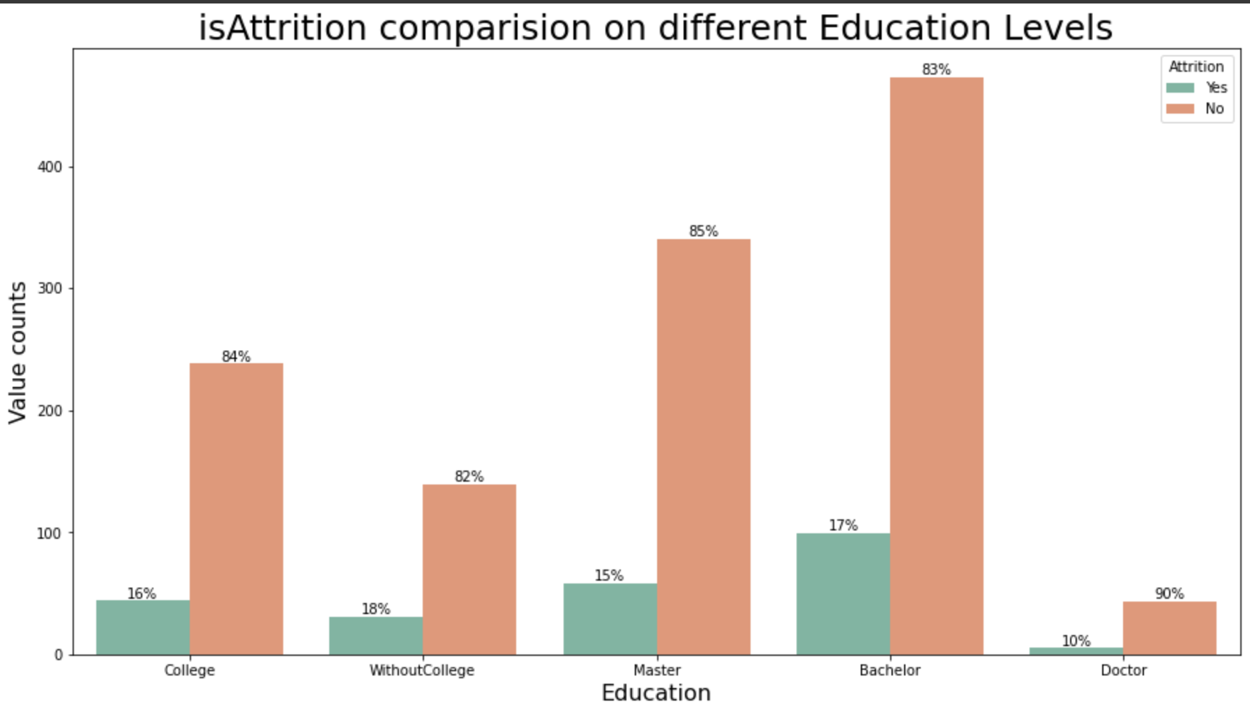
Exploratory Data Analysis - Education
*Most degrees candidates have similar rate of attrition but the doctor degree candidates have lowest attrition rate. It might be due to insufficient data points we have for doctors.

Slide 16
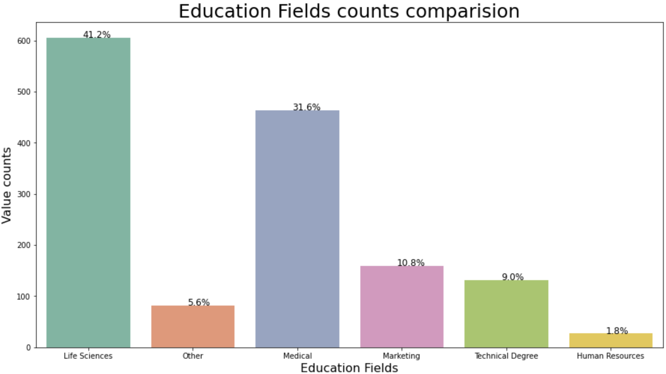
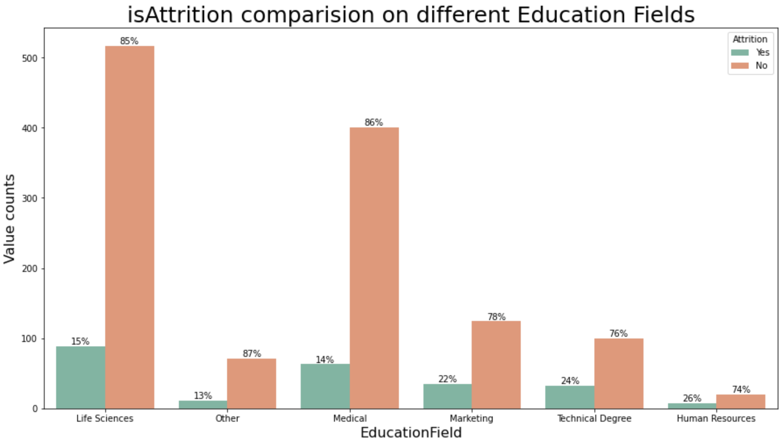
Exploratory Data Analysis - Education

Slide 17
Tested Several Feature Selection Techniques and Model Types
Feature Selection
Univariate selection (chi2)
Correlation matrix (Pearson)
Feature importance (ExtraTreesClassifier and inbuilt methods)
L1 regularization (logistic regression and SVC)
Example of Model Accuracy (table below)
On L1 regularization reduced features and synthetic minority oversampling technique to balance the data
Outcome
Decided that the feature selection technique should match the model type
Random forest gives the best predictions, but logistic regression offers valuable explanatory insight

Slide 18
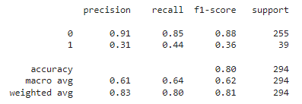
Predictive Modeling
Random Forest

Slide 19
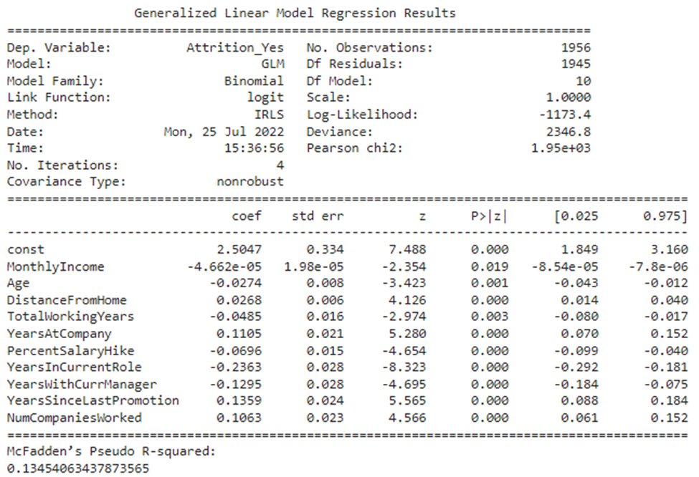
Explanatory Modeling
Binomial Regression (Generalized Linear Models)
The model predicts the odds of an event occuring (i.e., employee attrition). It’s similar to logistic regression
Features were selected using L1 lasso regularization (this helps remove redundant features)
Data was balanced using synthetic minority oversampling technique

Slide 20
What features matters most to attrition? (And what should be done about it?)
Compensation
Less likely to leave with higher monthly income (MonthlyIncomeGR)
Less likely to leave with larger percentage of salary hike (PercentSalaryHike^{G})
Monthly income as ranges (Monthy_IncomeRanges^{R})
Role
More frequent promotions (YearsSinceLastPromotion^{G})
Longer in role, less likely to leave (YearsInCurrentRole^{G})
Longer with current manager, less likely to leave (YearsWithCurrManager^{G})
Job satisfaction (JobSatisfaction^{R})
Work life balance (WorkLifeBalance^{R})
Working overtime (Overtime_Yes^{R})
Career Stage
Less likely to leave with increases in age (AgeGR)
Less likely to leave with additional years in the workforce (TotalWorkingYears^{G})
More likely to leave with additional years at IBM (YearsAtCompanyGR)
More likely to leave if worked from more companies previously (NumCompaniesWorked^{G})
Workplace
More likely to leave with greater distances from the office (DistanceFromHomeGR)
Environment satisfaction (EnvironmentStatisfaction^{R})
^{G} Based on GLM Binomial findings
^{R} Based on Random Forest findings

Slide 21
Recommendations
Using the findings on the previous slide, work with our team to craft an intervention that addresses:
Select a target group
Develop a strategy to decrease attrition
Expected results
Evaluation of success
Consider targeting high performers (performance rating of 4)
Review and modify existing employee retention programs
Increase data collection to overcome the main limitation of this project: small sample size

